Slide 1
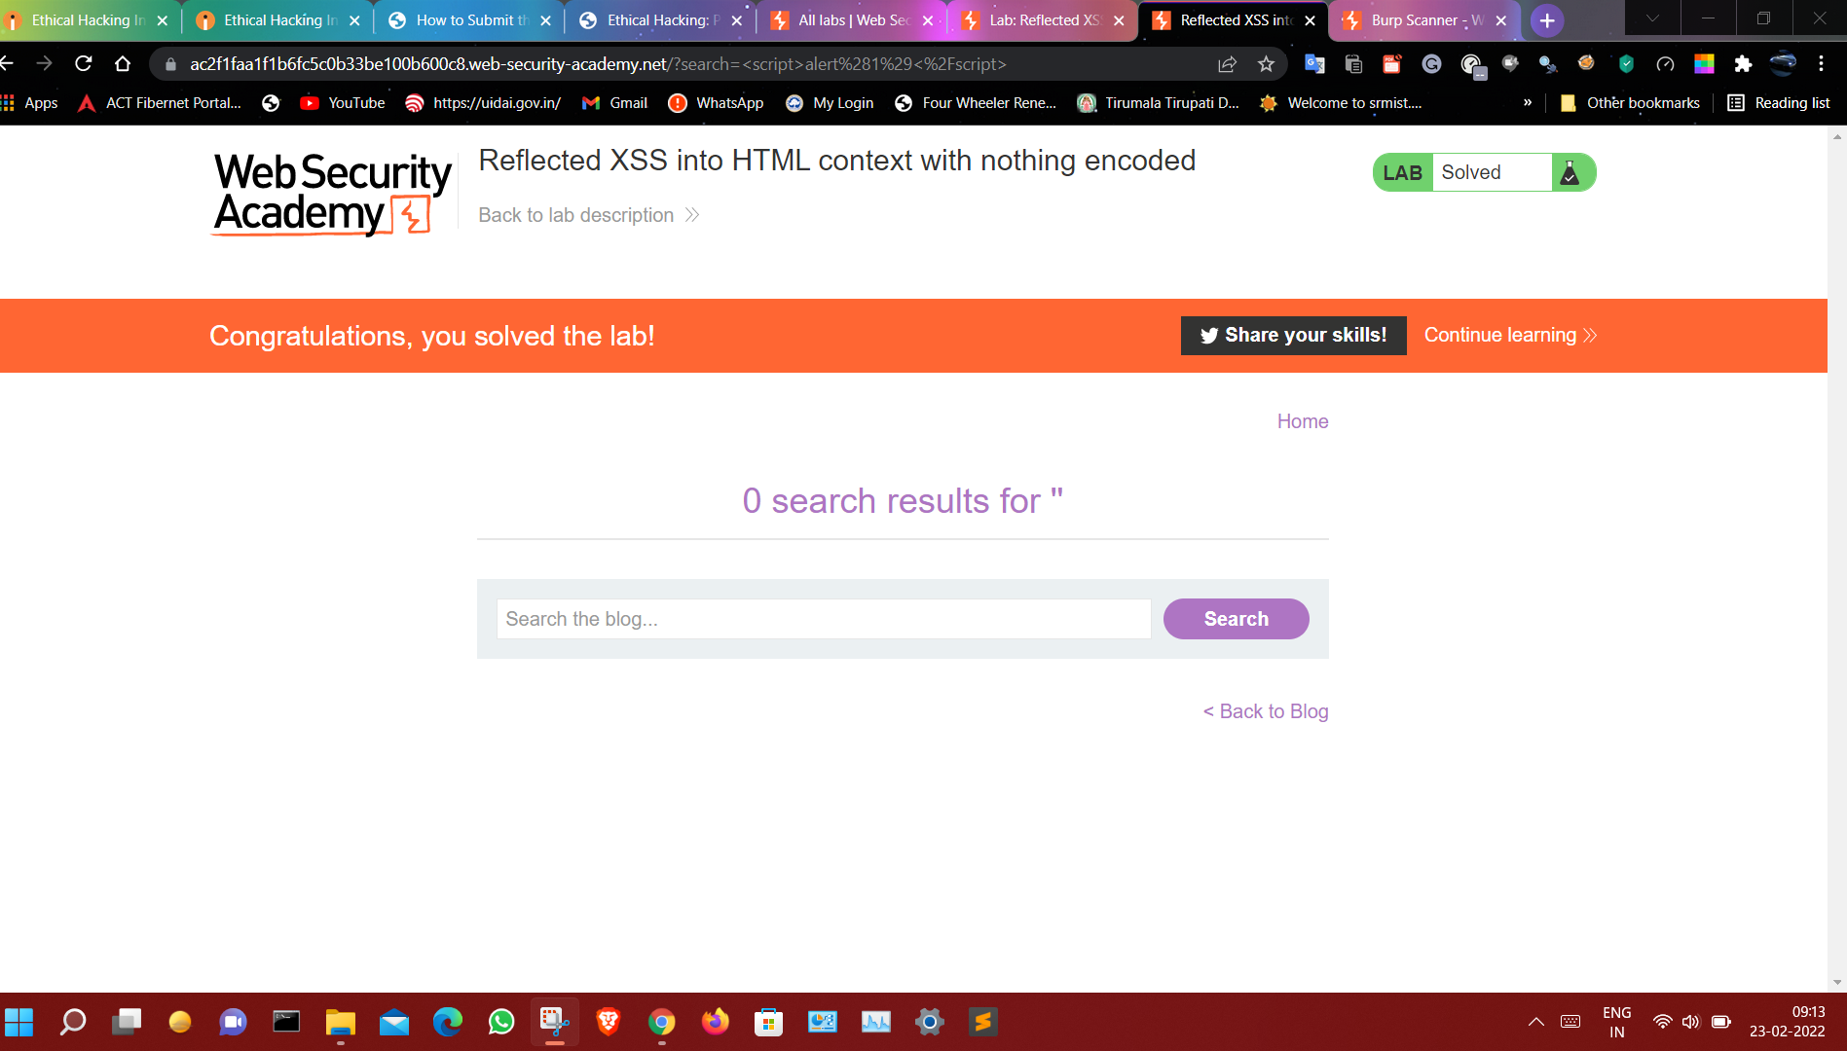
Task 1
Screenshot

Slide 2
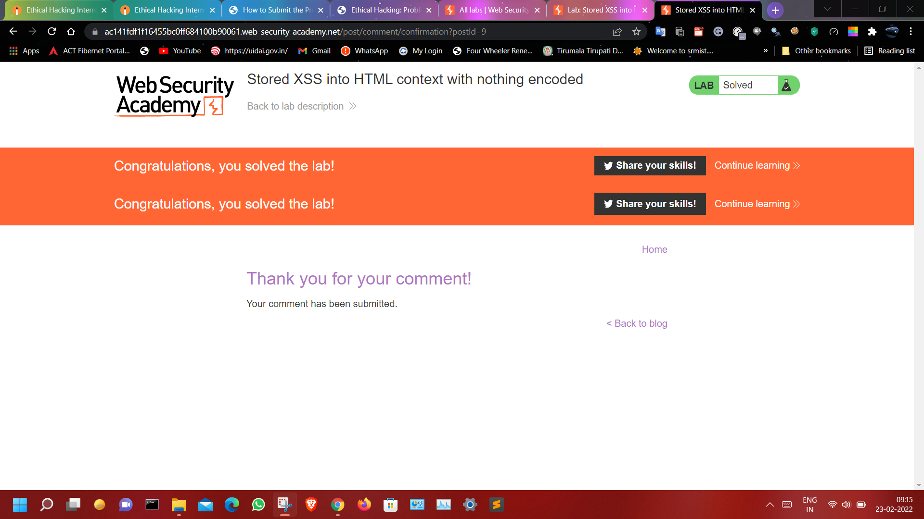
Screenshot – 2

Slide 3
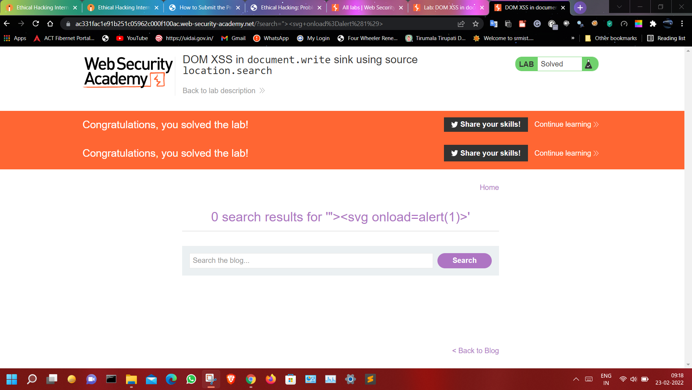
Screenshot – 3

Slide 4
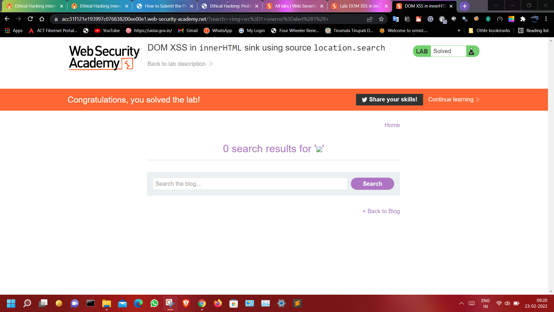
Screenshot – 4

Slide 5
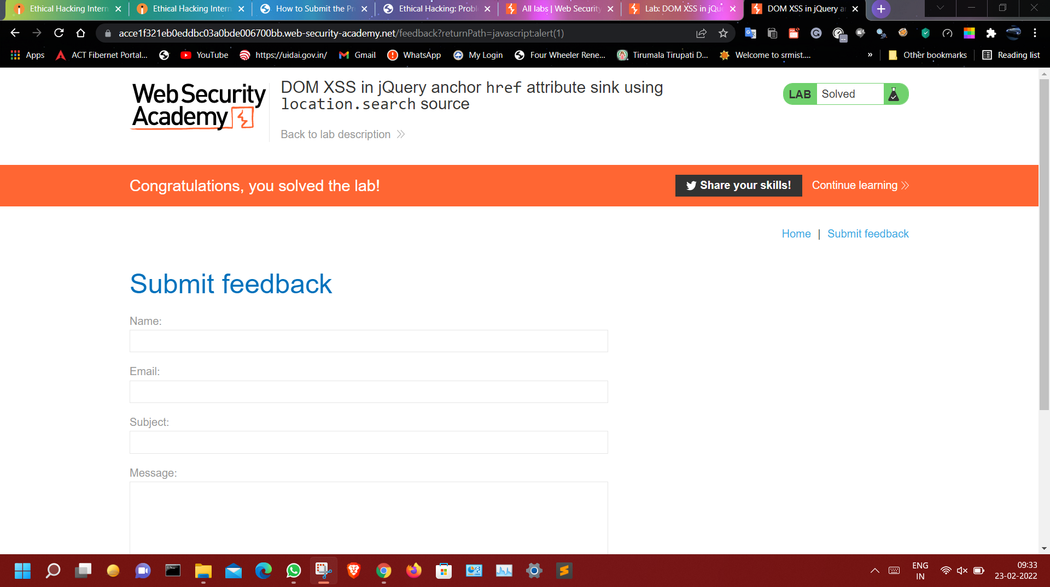
Screenshot – 5

Slide 6
Task-3
Title: Cross-Site Scripting
Domain: vulnweb.com
Subdomain: testasp.vulnweb.com
Steps To Reproduce
Step 1: Visit this link http://testasp.vulnweb.com/
Step 2: On the Menu bar you can find the Search Option.
Step 3: Click the Search Option on it and you will redirect to the Search page You can see the
Search Box on the Search page.
Step 4: Now you can check different payloads for XSS.
Step 5: Now check the vulnerabilities using script payload <script>alert(1)</script> and click the search posts.
Step 6: The payload executes and it vulnerable to XSS

Slide 7
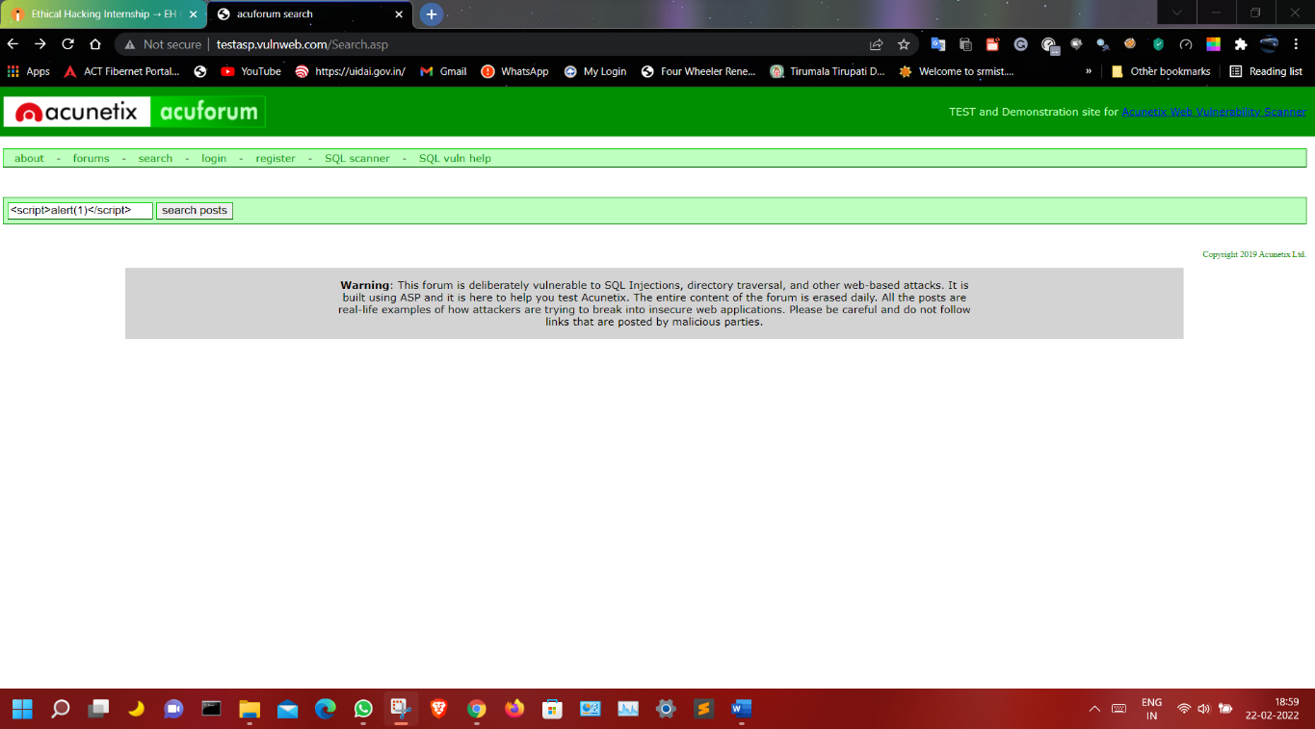
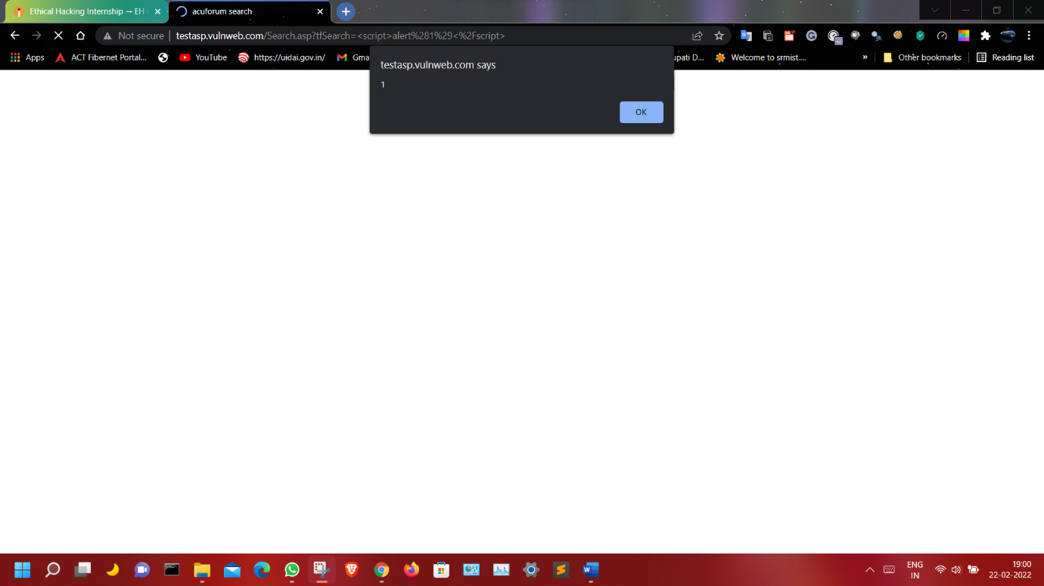
Image Demonstration
fig:1.1
fig:1.2

Slide 8
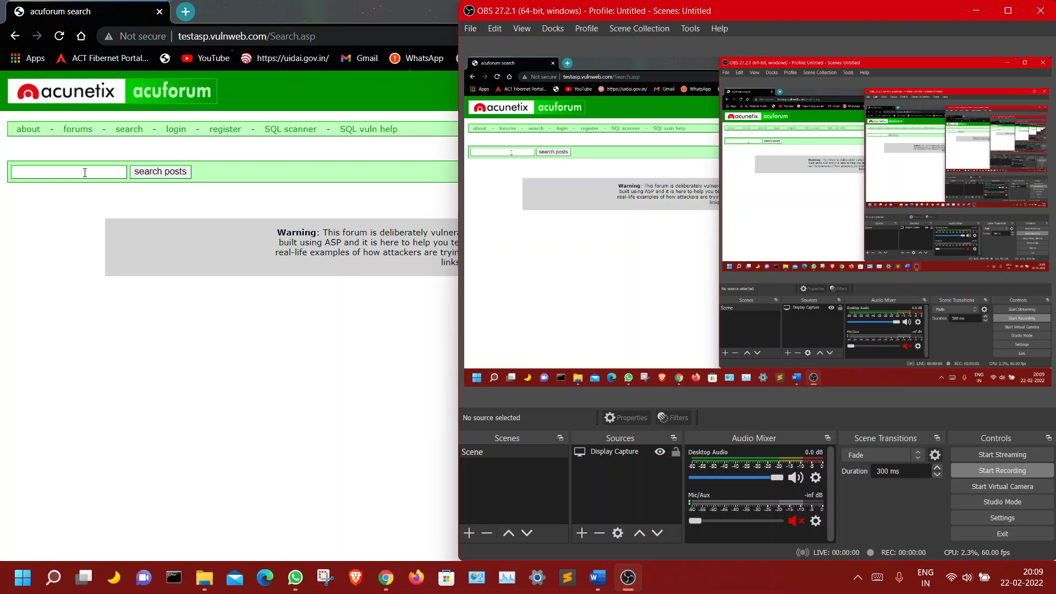
Video Demonstration

Slide 9
Vulnerability - 2
Title: SQL bypass vulnerabilities
Domain: vulnweb.com
Subdomain: testasp.vulnweb.com/search.asp
Steps To Reproduce
Step 1: First we must check whether the vulnerabilities is there or not.
Step 2: First we check the vulnerabilities like this (‘) checking that vulnerabilities is there or not.
Step 3: when execution is done then vulnerabilities is there After that By the pop-up.

Slide 10
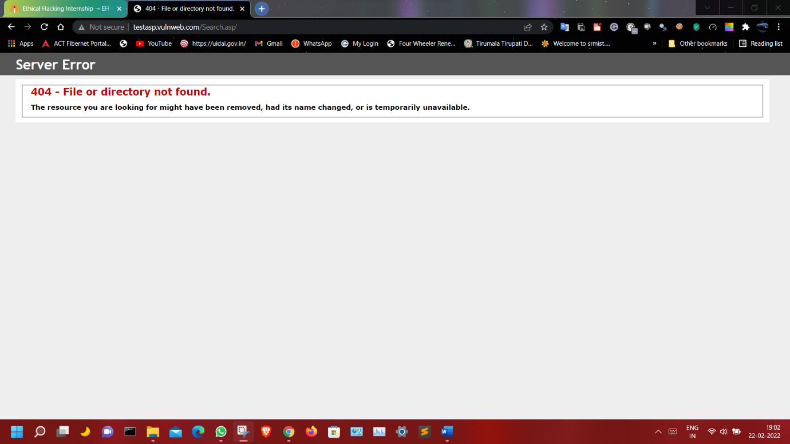
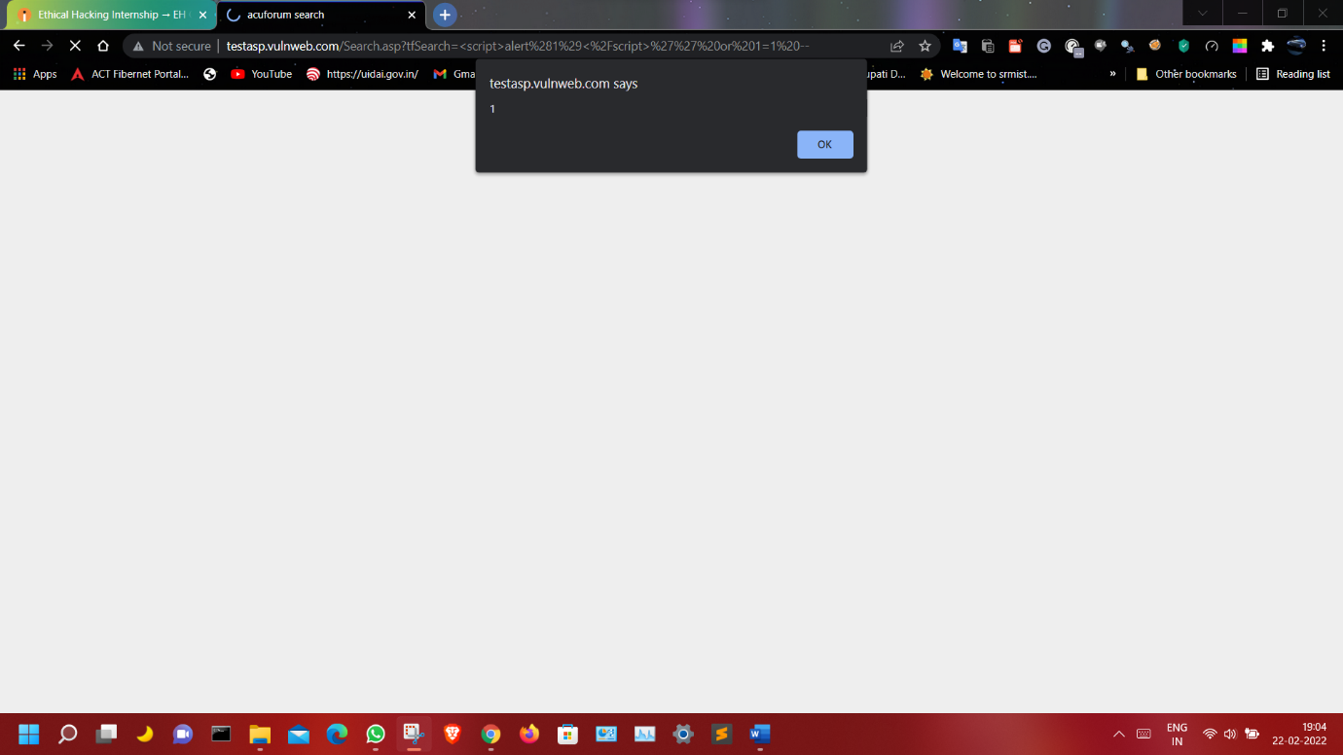
Image Demonstration
Fig:2.1
Fig:2.2

